Slide 1
Morphological Image Processing

Slide 2
Basics
Morphological operations can be used to remove imperfections in a generated image, normally used for binary images
Chapter Contents:
Structuring element
Erosion, Dilation
Opening, Closing
Chapter Exercise:
Get outline of an object in an image

Slide 3
Object & Background
White pixels are the ones which have a binary value of 1
Black pixels have a value of 0
By convention for a binary image, we consider
Black as the background
White as the object

Slide 4
Structuring Element
Structuring element is like kernel used for image filtering
It can be of any size and shape
0 | 1 | 1 | 1 | 0
1 | 1 | 1 | 1 | 1
1 | 1 | 1 | 1 | 1
1 | 1 | 1 | 1 | 1
0 | 1 | 1 | 1 | 0
1 | 1 | 1
1 | 1 | 1
1 | 1 | 1
0 | 1 | 0
1 | 1 | 1
0 | 1 | 0

Slide 5
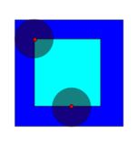
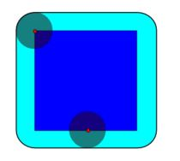
Erosion & Dilation
Erosion: When structuring element is completely contained inside the object, the locus of the center defines the output
So boundary of the object gets deleted mostly
Dilation: When structuring element’s center is contained in the object, the structuring element defines the output
So boundary of the object gets stretched mostly

Slide 6



Erosion - Example
Original image
Erosion by 5x5 square structuring element
Erosion by 7x7 square structuring element

Slide 7




What Is Erosion For?
Erosion can split apart joined objects
Erosion can strip away extrusions
Watch out: Erosion shrinks objects

Slide 8


Dilation - Example
Dilation by 5x5 square structuring element
Dilation by 7x7 square structuring element
Original image

Slide 9




What Is Dilation For?
Dilation can repair breaks
Dilation can repair intrusions
Watch out: Dilation enlarges objects

Slide 10
Compound Operations
Image Opening
Erosion followed by a dilation
Image Closing
Dilation followed by an erosion

Slide 11
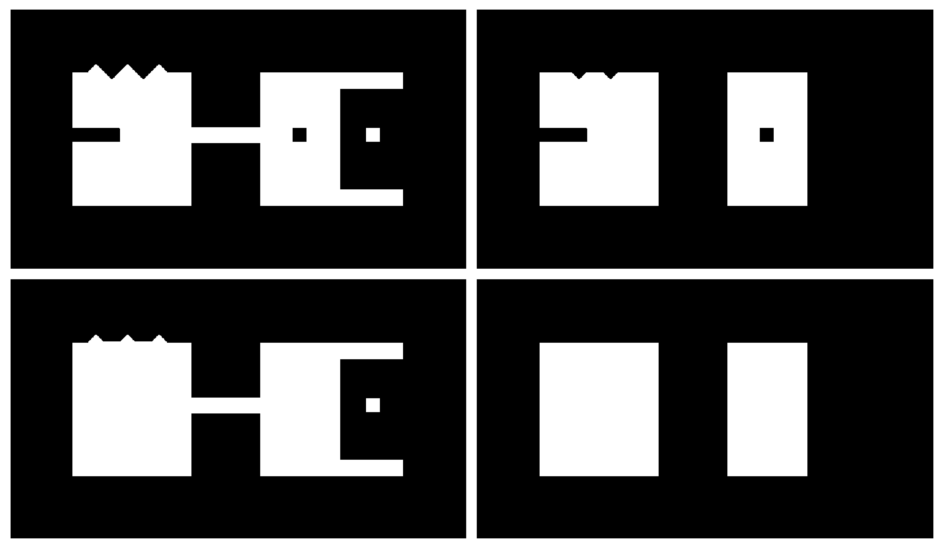
Opening Example
Original Image
Image After Opening

Slide 12
Closing Example
Original Image
Image After Closing

Slide 13
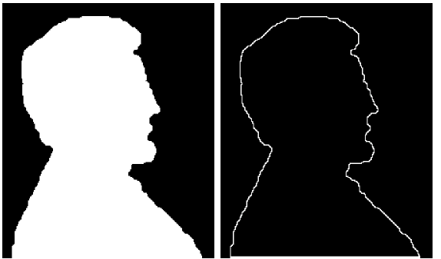
Boundary Extraction Example
A simple image and the result of performing boundary extraction using a square 3*3 structuring element
First erode the original image and then subtract the eroded image from original image to get object boundary
Possible using dilation also: THINK ABOUT IT
Original Image
Extracted Boundary

